Slide 1
City Garden Sales Performance Analysis_Dashboard
File created on: 10/21/2024 6:34:20 PM

Slide 2
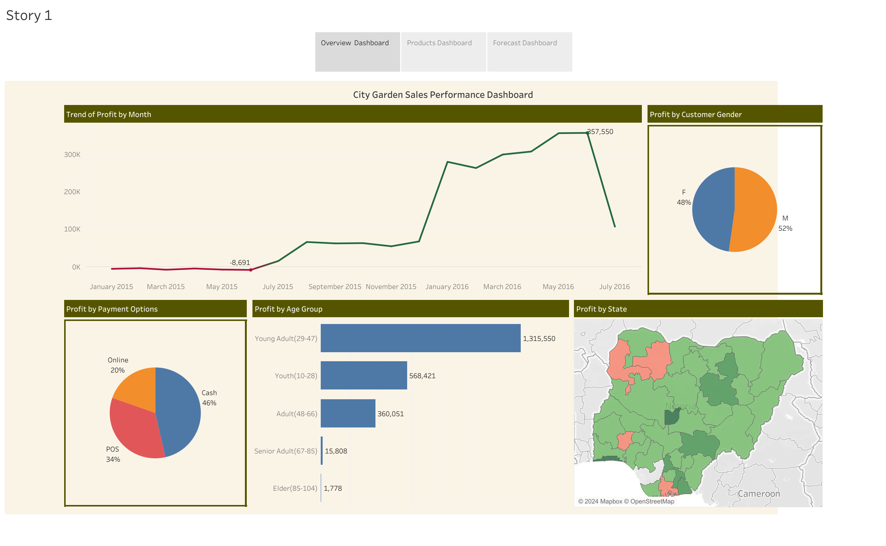

Slide 3
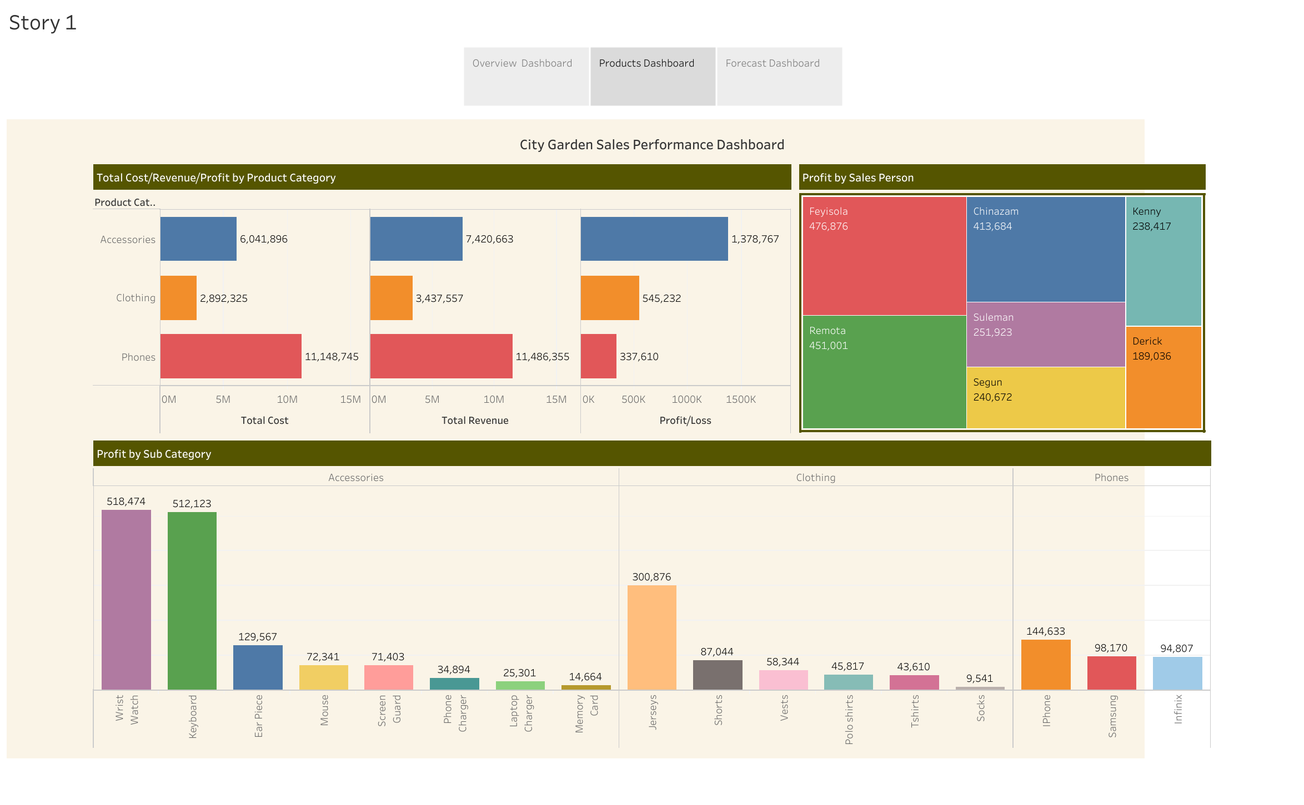

Slide 4
